Slide 1
Construction
Project Proposal
Here is where your project begins

Slide 2
Introduction: the idea
01.
Efficiency Techniques
Dataset Creation
04.
02.
Mobile Deployment
Training the model
05.
03.
Conclusions (test?)
06.
Key points and concept
Here you could describe the topic of the section
Here you could describe the topic of the section
Here you could describe the topic of the section
Here you could describe the topic of the section
Here you could describe the topic of the section

Slide 3

The Idea
This project aims to create a lightweight CNN that detects and classifies AI-generated images, identifying the specific AI model used for their creation.

Slide 4
Key Points
MobileNet V2
A
A lightweight convolutional neural network designed for efficient mobile and embedded vision applications.
B
Fine Tuning
To Adjust MobileNet on the task of Fake image detection.
C
Effeciency Techniques
Usage of Pruning and Knoldedge distillation to improve Efficiency and Performance.
D
Mobile Deployement
Deploy of the ligthweight model on a mobile app.

Slide 5
Dataset Creation
Structure
We have build a dataset of 46000 samples of both fake and real images.
Fakes images
The fake samples come from the dataset: Diffusion-generated Deepfake Detection dataset [1].
Real images
Real images come directly from ImageNet.
[1] https://aimagelab.ing.unimore.it/imagelab/page.asp?IdPage=57.

Slide 6
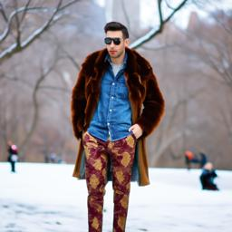

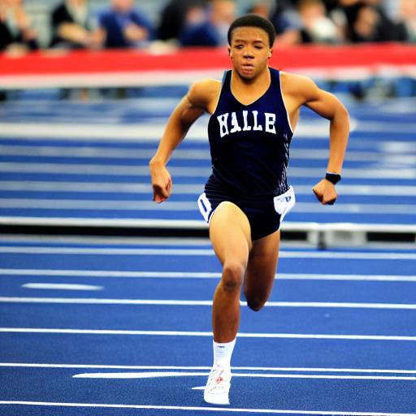
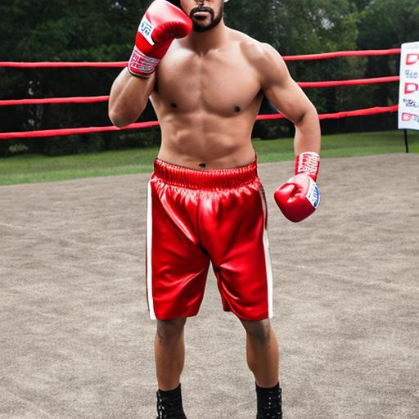
Dataset: some samples
Stable Diffusion 1.4
Stable Diffusion 2.1
DeepFloyd IF
Stable Diffusion xl

Slide 7
Training the model
Base net
We used MobileNetv2 as a base model and trained it using a split of (0.8, 0.1 , 0.1) of the dataset.
Different Approaches
We explored different model in order to achieve the best accuracy with the limited resources of colab.
Monitoring Performances
Each model has been evaluated so to have an overview of its performance.

Slide 8
The models: v1
224x224 image
Model : it consisted of MobileNet v2 connected to two fully connected layers of 256 and 128 neurons respectly.
Output : consisted of 5 neurons and used softmax as activation function.
Parameters : Tested on batch size of 32/64/128.
Fine tuning : Tested with both MobileNet locked and with the last 5 layers unlocked.
ImageNet v2
Global Average Pooling
FCC 256 Neurons
FCC 128 Neurons
Output Layer
(softmax)

Slide 9
The models: v2
224x224 image
Model : it consisted of MobileNet v2 connected to two fully connected layers of 256 and 128 neurons respectly.
Output : consisted of 5 neurons and used softmax as activation function.
Parameters : Tested on batch size of 32/64/128.
Fine tuning : Tested with both MobileNet locked and with the last 5 layers unlocked.
ImageNet v2
Global Average Pooling
FCC 128 Neurons
Output Layer
(softmax)

Slide 10
The models: v3
224x224 image
Model : it consisted of MobileNet v2 connected to two fully connected layers of 256 and 128 neurons respectly.
Output : consisted of 5 neurons and used softmax as activation function.
Parameters : Tested on batch size of 64/128.
Fine tuning : Tested with 6 and 8 unlocked layer of MobileNet.
ImageNet v2
Global Average Pooling
Output Layer
(softmax)

Slide 11
Training Results
Model | Batch Size | N. Layer locked | Loss | Training accuracy | Validation Loss | Validation Accuracy
All model were trained for a number of epochs that varied between 15/20.

Slide 12
Training Results
Inseriamo le immagini dei grafici qui
Validation performance
Validation performance
blablablbldffdassssssssssssssssssssssssssssssssssssssssssssssssssssssssssss
blablablbldffdassssssssssssssssssssssssssssssssssssssssssssssssssssssssssss

Slide 13
Training Results
Qui possiamo mettere le confusion matrix del modello migliore!
Validation performance
Validation performance
blablablbldffdassssssssssssssssssssssssssssssssssssssssssssssssssssssssssss
blablablbldffdassssssssssssssssssssssssssssssssssssssssssssssssssssssssssss

Slide 14
Efficency techniques
The best model obtained in the training was subjected to pruning and knoledge distillation .
Pruning to reduce the model complexity and to make it mobile-ready.
Knoledge distillation using the pruned model as student and the original model as teacher, to further improve the pruned model.
Performances before and after have monitored and compared.

Slide 15
Efficiency Techniques
Before
After
Model summary with parameters
Model size
Model summary with parameters
Model size

Slide 16
Efficiency Techniques
Before
After
Cf matrix
Cf matrix

Slide 17
Mobile Deployement
The mobile deployment were done using tensorflow Lite.
A Conversion using TF lite was required to procede with the deployment.
A simple and straightforward app has been developed using AndroidStudio.

Slide 18
Mobile Deployement: inference
The original idea was to detect real and fake images, and possibly performs attribution on the fake samples.
It may happen that the model receives an unseen sample generated by an unknown model.
Analizing the model performances in introduced app sided control to perform inference for this specific situation;

Slide 19
Mobile deployment

Slide 20
Mobile deployment

Slide 21
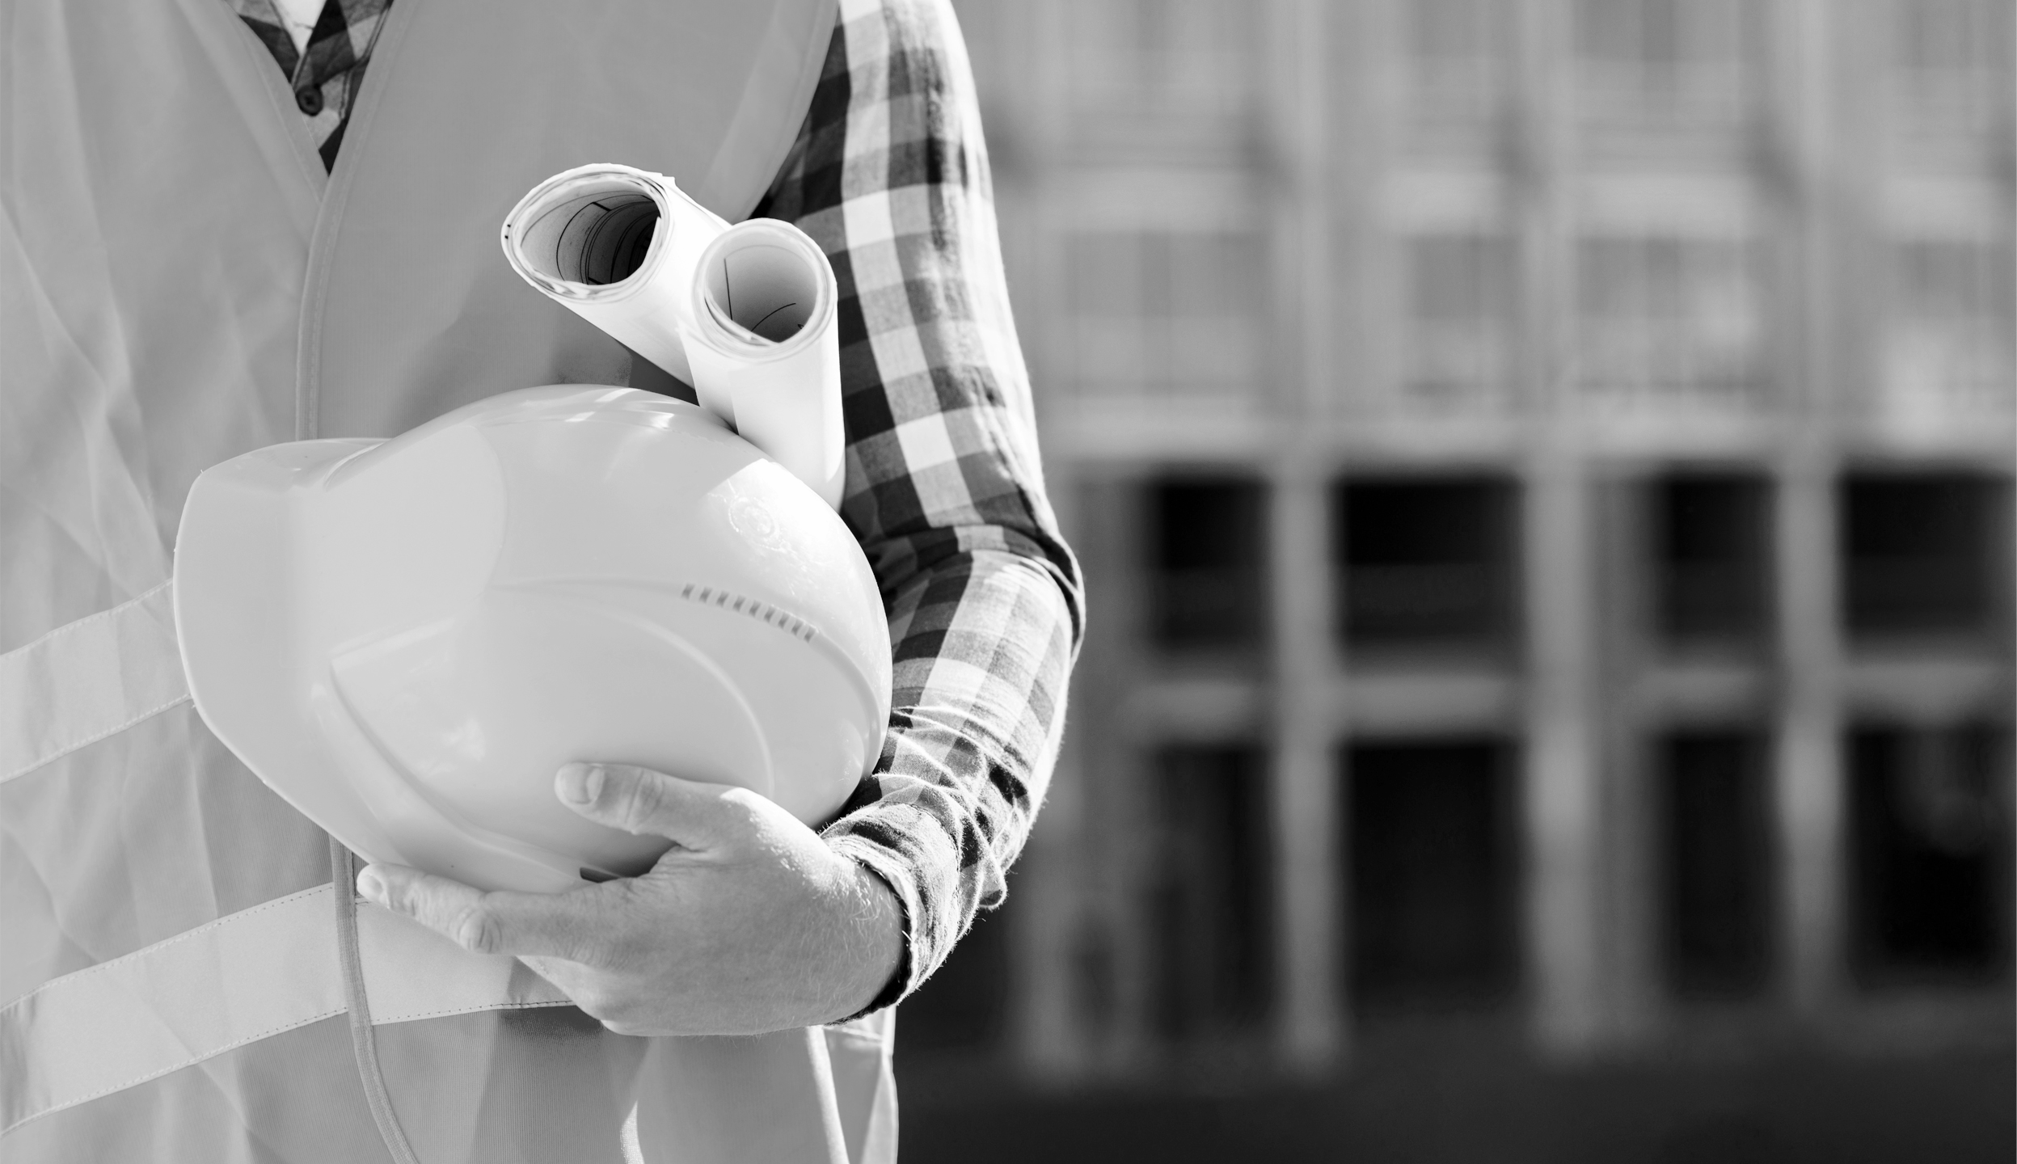
Sneak Peek
Insert your multimedia content here

Slide 22
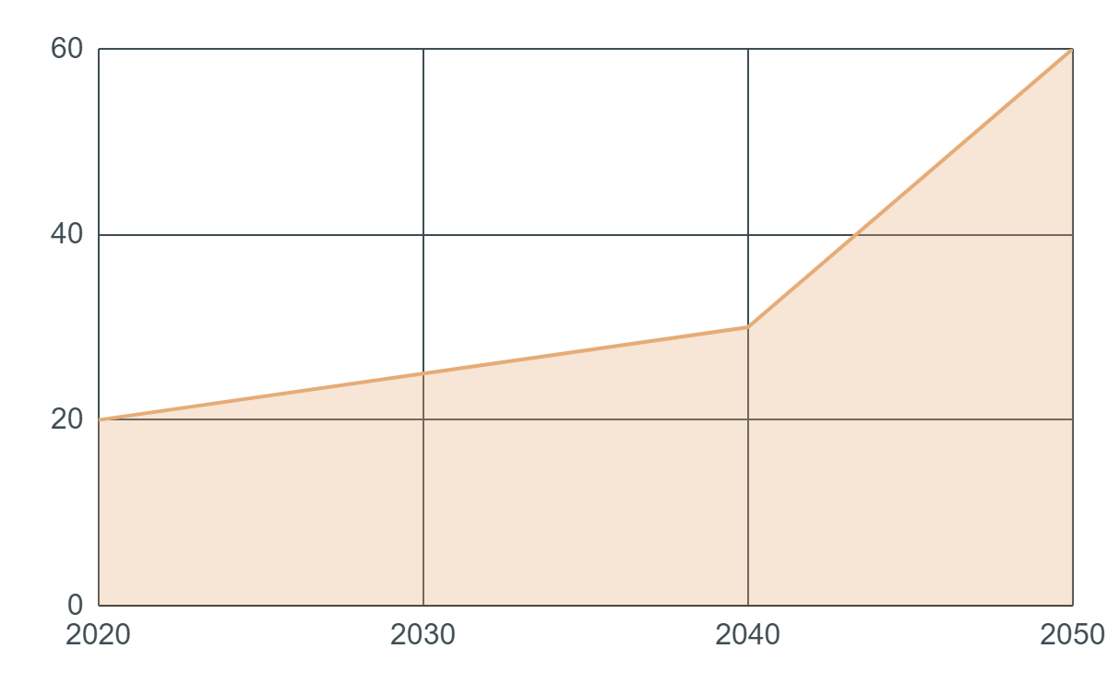
Predicted Results
To modify this graph, click on it, follow the link, change the data and paste the new graph here
You can write about the predicted results here
You can write about the predicted results here
You can write about the predicted results here
You can write about the predicted results here

Slide 23
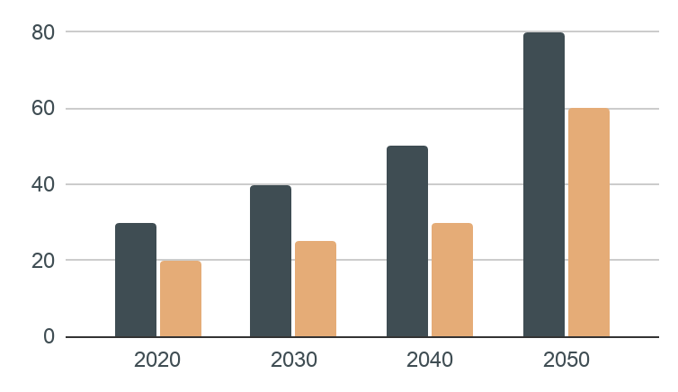
Predicted Results
450,000
The closest planet to the Sun and the smallest one
678,300
Neptune has a beautiful name and is the second planet
To modify this graph, click on it, follow the link, change the data and paste the new graph here

Slide 24
Predicted Results
2k
10%
130
Mercury
Venus
Mars
Is the closest planet to the Sun and the smallest one
Venus is terribly hot and its atmosphere is poisonous
Despite being red, Mars is a cold place, not hot

